Slide 1

Department of Computer Science & Engineering "Amazon Sales Forecasting & Analytics: Trends, Insights, and Performance" Batch no. B-91 1. 2211CS010379 (M.SAIRAM) 2. 2211CS010438(P.NIKHITHA) 3. 2211CS010367(M.VINAY) 4.2211CS010209(G.KISHORE) Guide Mr.G.Raju
Maisammaguda, Kompally, Medchal - Malkajgiri District Hyderabad - 500100, Telangana State. www.mallareddyuniversity.
(Telangana State Private Universities Act No. 13 of 2020 &
G.O.Ms. No. 14, Higher Education (UE) Department)

Slide 2
Table of Contents
Abstract.
Introduction.
Existing algorithms
Proposed statement
Proposed methodology
Objectives.
Methodology.
Implementation.
Results .
Conclusion & Future Scope .
References.

Slide 3
Title Explanation
This project focuses on Amazon sales data analysis and forecasting. This title perfectly aligns with the project's scope. Here's a breakdown:
Amazon Sales Forecasting & Analytics
Amazon Sales → Represents that the project deals with Amazon marketplace sales data.
Forecasting → Emphasizes the predictive analytics aspect, which helps analyze historical data to predict future sales trends.
Analytics → Involves detailed sales data analysis, uncovering patterns, trends, and insights.
Trends & Insights
Trends → The project identifies historical sales patterns, such as regional variations, and product sales fluctuations.
Insights → The analysis provides meaningful business intelligence, helping sellers understand past sales performance.
Performance
The project evaluates key sales performance indicators (KPIs) like total revenue, profit, units sold, and order priority.
The visual dashboards and graphs help analyze regional sales, product demand, and unit price distribution, making the data easy to interpret.

Slide 4
Abstract
The Amazon Sales Data Analysis project is an interactive dashboard designed to explore and forecast Amazon sales trends using data visualization and predictive analytics. Built with Dash, Plotly, Pandas, and Machine Learning algorithms, the application provides insights into key sales metrics such as revenue, profit, units sold, and regional sales performance. The dashboard allows users to filter the data by product category, region, and order priority, providing customized insights into sales trends, price distributions, and profitability.
Predictive modeling techniques, including Linear Regression and PyCaret, are used to forecast future sales trends and evaluate model performance with metrics like Mean Absolute Error (MAE), Mean Squared Error (MSE), and R² score. The application preprocesses raw sales data, handling missing values and structuring fields such as total revenue, total cost, and unit price for analysis.
The dashboard highlights important patterns such as order processing times, cost outliers, and sales trends based on order priority, helping businesses refine strategies. Machine Learning techniques like Lasso and Least Angle Regression (LARS) are explored for feature selection and model optimization.
By integrating interactive visualizations with predictive analytics, this project empowers businesses to improve sales strategies, optimize inventory, and enhance profitability in the competitive e-commerce landscape.

Slide 5
Introduction
In today's competitive e-commerce landscape, data-driven decision-making is crucial for businesses to maximize revenue and optimize sales strategies. The Amazon Sales Data Analysis project is designed to provide insights into sales trends, revenue distribution, and product performance through interactive visualizations and predictive analytics. This project utilizes Dash, Plotly, Pandas, and Machine Learning (ML) techniques to analyze historical sales data, forecast future trends, and evaluate sales performance across different regions and products.
The primary objective of this project is to help businesses and analysts understand key sales metrics, including total revenue, profit margins, units sold, and regional sales patterns. By leveraging data preprocessing, visualization, and predictive modeling, the project enables users to identify high-performing products, seasonal sales trends, and potential inefficiencies in order processing.
To enhance predictive capabilities, the project incorporates Machine Learning algorithms such as Linear Regression, Lasso Regression, and Least Angle Regression (LARS) for sales forecasting and revenue prediction. Performance evaluation is conducted using statistical metrics like Mean Absolute Error (MAE), Mean Squared Error (MSE), Root Mean Squared Error (RMSE), R² score, Root Mean Squared Logarithmic Error (RMSLE), and Mean Absolute Percentage Error (MAPE). The PyCaret library is also used to compare multiple models and automate predictive analytics.
Additionally, Kernel Density Estimation (KDE) plots are utilized to analyze data distributions, while anomaly detection techniques help identify irregularities in sales data. The dashboard allows users to filter data dynamically based on products and geographical regions, providing customized insights through interactive visualizations.
By integrating real-time data processing, advanced visualizations, and predictive analytics, this project serves as a valuable tool for business intelligence and decision-making. The insights generated can help improve sales strategies, optimize pricing models, forecast demand, and enhance overall operational efficiency in the ecommerce domain.

Slide 6
Objectives
The Amazon Sales Data Analysis project aims to provide an interactive, data-driven solution for analyzing and predicting sales trends. The primary goal is to help businesses extract meaningful insights from historical sales data to enhance decision-making, forecasting, and operational efficiency.
The specific objectives of the project are:
1.Analyze Sales Trends – Identify patterns in revenue, profit, and units sold over time to understand fluctuations in Amazon sales performance.
2.Develop an Interactive Dashboard – Create a user-friendly web application using Dash and Plotly to visualize sales data dynamically, allowing users to filter insights based on products and regions.
3.Predict Future Sales – Implement Machine Learning models (Linear Regression, Lasso Regression, and Least Angle Regression - LARS) to forecast future revenue and product demand based on historical trends.

Slide 7
4.Evaluate Model Performance – Quantify model accuracy using statistical metrics such as Mean Absolute Error (MAE), Mean Squared Error (MSE), Root Mean Squared Error (RMSE), R² score, Root Mean Squared Logarithmic Error (RMSLE), and Mean Absolute Percentage Error (MAPE).
5.Compare Multiple ML Models – Utilize PyCaret, an automated machine learning library, to compare different predictive models and determine the most accurate approach for sales forecasting.
6.Detect Anomalies in Sales Data – Identify outliers and irregularities in sales, cost, and order processing using Kernel Density Estimation (KDE) plots and anomaly detection techniques.
7.Improve Business Decision-Making – Enable businesses to optimize inventory management, refine pricing strategies, and allocate resources effectively by leveraging data-driven insights.

Slide 8
Existing algorithms
1. Amazon Seller Central Analytics
✅ Provides sales reports, order tracking, and advertising insights.
❌ Lacks predictive modeling for future sales forecasting.
2. Google Analytics (E-commerce Tracking)
✅ Tracks website traffic, customer behavior, and conversion rates.
❌ No built-in sales trend forecasting capabilities.
Limitations of Existing Systems
🚫 Focus mainly on descriptive analytics rather than predictive modeling.
🚫 Lack automated feature selection and machine learning integration.
🚫 Limited flexibility in customizing forecasting models.
How Our System Improves Upon Existing Ones
✅ Integrates data visualization with machine learning for accurate forecasting.
✅ Uses regression models (Lasso, LARS) for better feature selection.
✅ Provides real-time insights with interactive filters for decision-making.

Slide 9
Proposed statement
This project aims to develop an interactive Amazon Sales Data Analysis Dashboard that leverages data visualization and predictive analytics to analyze sales trends and forecast future performance. Using Dash, Plotly, Pandas, and Machine Learning algorithms, the dashboard will provide insights into key sales metrics, including revenue, profit, units sold, and regional performance.
To enhance predictive accuracy, the project will implement Linear Regression, Lasso Regression, and Least Angle Regression (LARS), along with PyCaret for automated model selection. The forecasting models will be evaluated using Mean Absolute Error (MAE), Mean Squared Error (MSE), and R² score. The dashboard will feature interactive filters for product category, region, and order priority, enabling users to explore price distributions, sales trends, and cost outliers dynamically.
By integrating data preprocessing, feature selection, and predictive modeling, this project will empower businesses to refine sales strategies, optimize inventory management, and enhance profitability in the competitive e-commerce landscape.

Slide 10
Predictive Modeling & Machine Learning Techniques
1. Predictive Modeling Techniques
Linear Regression: Establishes a relationship between sales and influencing factors for trend forecasting.
PyCaret: An AutoML tool that automates model selection, training, and hyperparameter tuning for better predictions.
2. Feature Selection & Optimization
Lasso Regression: Uses L1 regularization to remove irrelevant features, preventing overfitting.
Least Angle Regression (LARS): Efficiently selects the most important variables in datasets with correlated features.
3. Model Performance Evaluation Metrics
Mean Absolute Error (MAE): Measures the average absolute difference between actual and predicted sales.
Mean Squared Error (MSE): Similar to MAE but penalizes larger errors more.
R² Score: Indicates how well the model explains sales variations (closer to 1 is better).
These techniques improve forecasting accuracy, feature selection, and business decision-making for Amazon sales analysis.

Slide 11
Proposed Methodology
1. Data Collection
2. Data Preprocessing
3. Data Analysis
4. Predictive Modeling and Model Evaluation
5. Interactive Visualization
6. Real-time Data Processing
7. Model Optimization
8. Anomaly Detection
9. Deployment
10. Outcome and Insights

Slide 12
1.Data Collection:
The project utilizes a dataset that includes historical Amazon sales data, including metrics like order date, ship date, units sold, revenue, cost, profit, and region. The raw data is sourced from CSV files, with the data structured for analysis using Pandas.
2.Data Preprocessing:
Data cleaning is the first step, where the following tasks are performed:
Handling Missing Values: Missing values in columns such as total revenue, total cost, and units sold are addressed by filling or removing them based on the nature of the data.
Date Conversion: Order Date and Ship Date are converted into the appropriate datetime format for time-based analysis.
Feature Engineering: Additional features like Year, Month, and Processing Time (calculated as the difference between Order Date and Ship Date) are created for more granular analysis.
Data Filtering: The application enables dynamic filtering of the data by product category, region, and order priority.
3.Data Analysis:
The cleaned and preprocessed data is used to analyze sales patterns and trends. Key metrics, including revenue, profit, units sold, and regional sales performance, are analyzed through descriptive statistics and visualized using Plotly.

Slide 13
4.Predictive Modeling:
Several machine learning techniques are used to forecast future sales and optimize the models:
Linear Regression: This technique is used for sales forecasting based on historical data. It helps predict future sales trends and analyze relationships between independent and dependent variables.
Lasso and Least Angle Regression (LARS): These methods are employed for feature selection, which helps identify the most important features contributing to sales predictions.
Model Evaluation: Model performance is evaluated using various statistical metrics such as Mean Absolute Error (MAE), Mean Squared Error (MSE), Root Mean Squared Error (RMSE), R² score, and Mean Absolute Percentage Error (MAPE).
5.Interactive Visualization:
Interactive visualizations are created using Dash and Plotly. The dashboard includes multiple graphs and plots to allow users to explore trends, regional sales distribution, unit price distributions, profitability comparisons, and more. Visualizations include:
Sales trends over time.
Regional sales performance.
Unit price distributions and profit comparisons.

Slide 14
6. Real-time Data Processing:
The application allows users to interactively filter the data based on various criteria such as product type, region, and order priority. This helps users get customized insights tailored to their business needs.
7.Model Optimization:
Model optimization techniques, including hyperparameter tuning and cross-validation, are applied to enhance model performance. PyCaret, an automated machine learning library, is used to compare and select the best model for forecasting.
8.Anomaly Detection:
The project identifies cost outliers and anomalies in sales patterns. This helps businesses detect irregularities in the data that may require attention, such as unexpectedly high costs or sales dips.
9.Deployment:
The final dashboard is deployed as a web application using Dash, allowing businesses to interact with the data and gain actionable insights in real-time. Users can filter and visualize the data in a way that aids in decision-making and sales strategy optimization.
10.Outcome and Insights:
The methodology ensures that the project delivers accurate, data-driven insights into sales forecasting, profitability, inventory optimization, and business performance. The interactive nature of the dashboard empowers businesses to make informed decisions that can help enhance sales strategies and improve overall profitability.

Slide 15
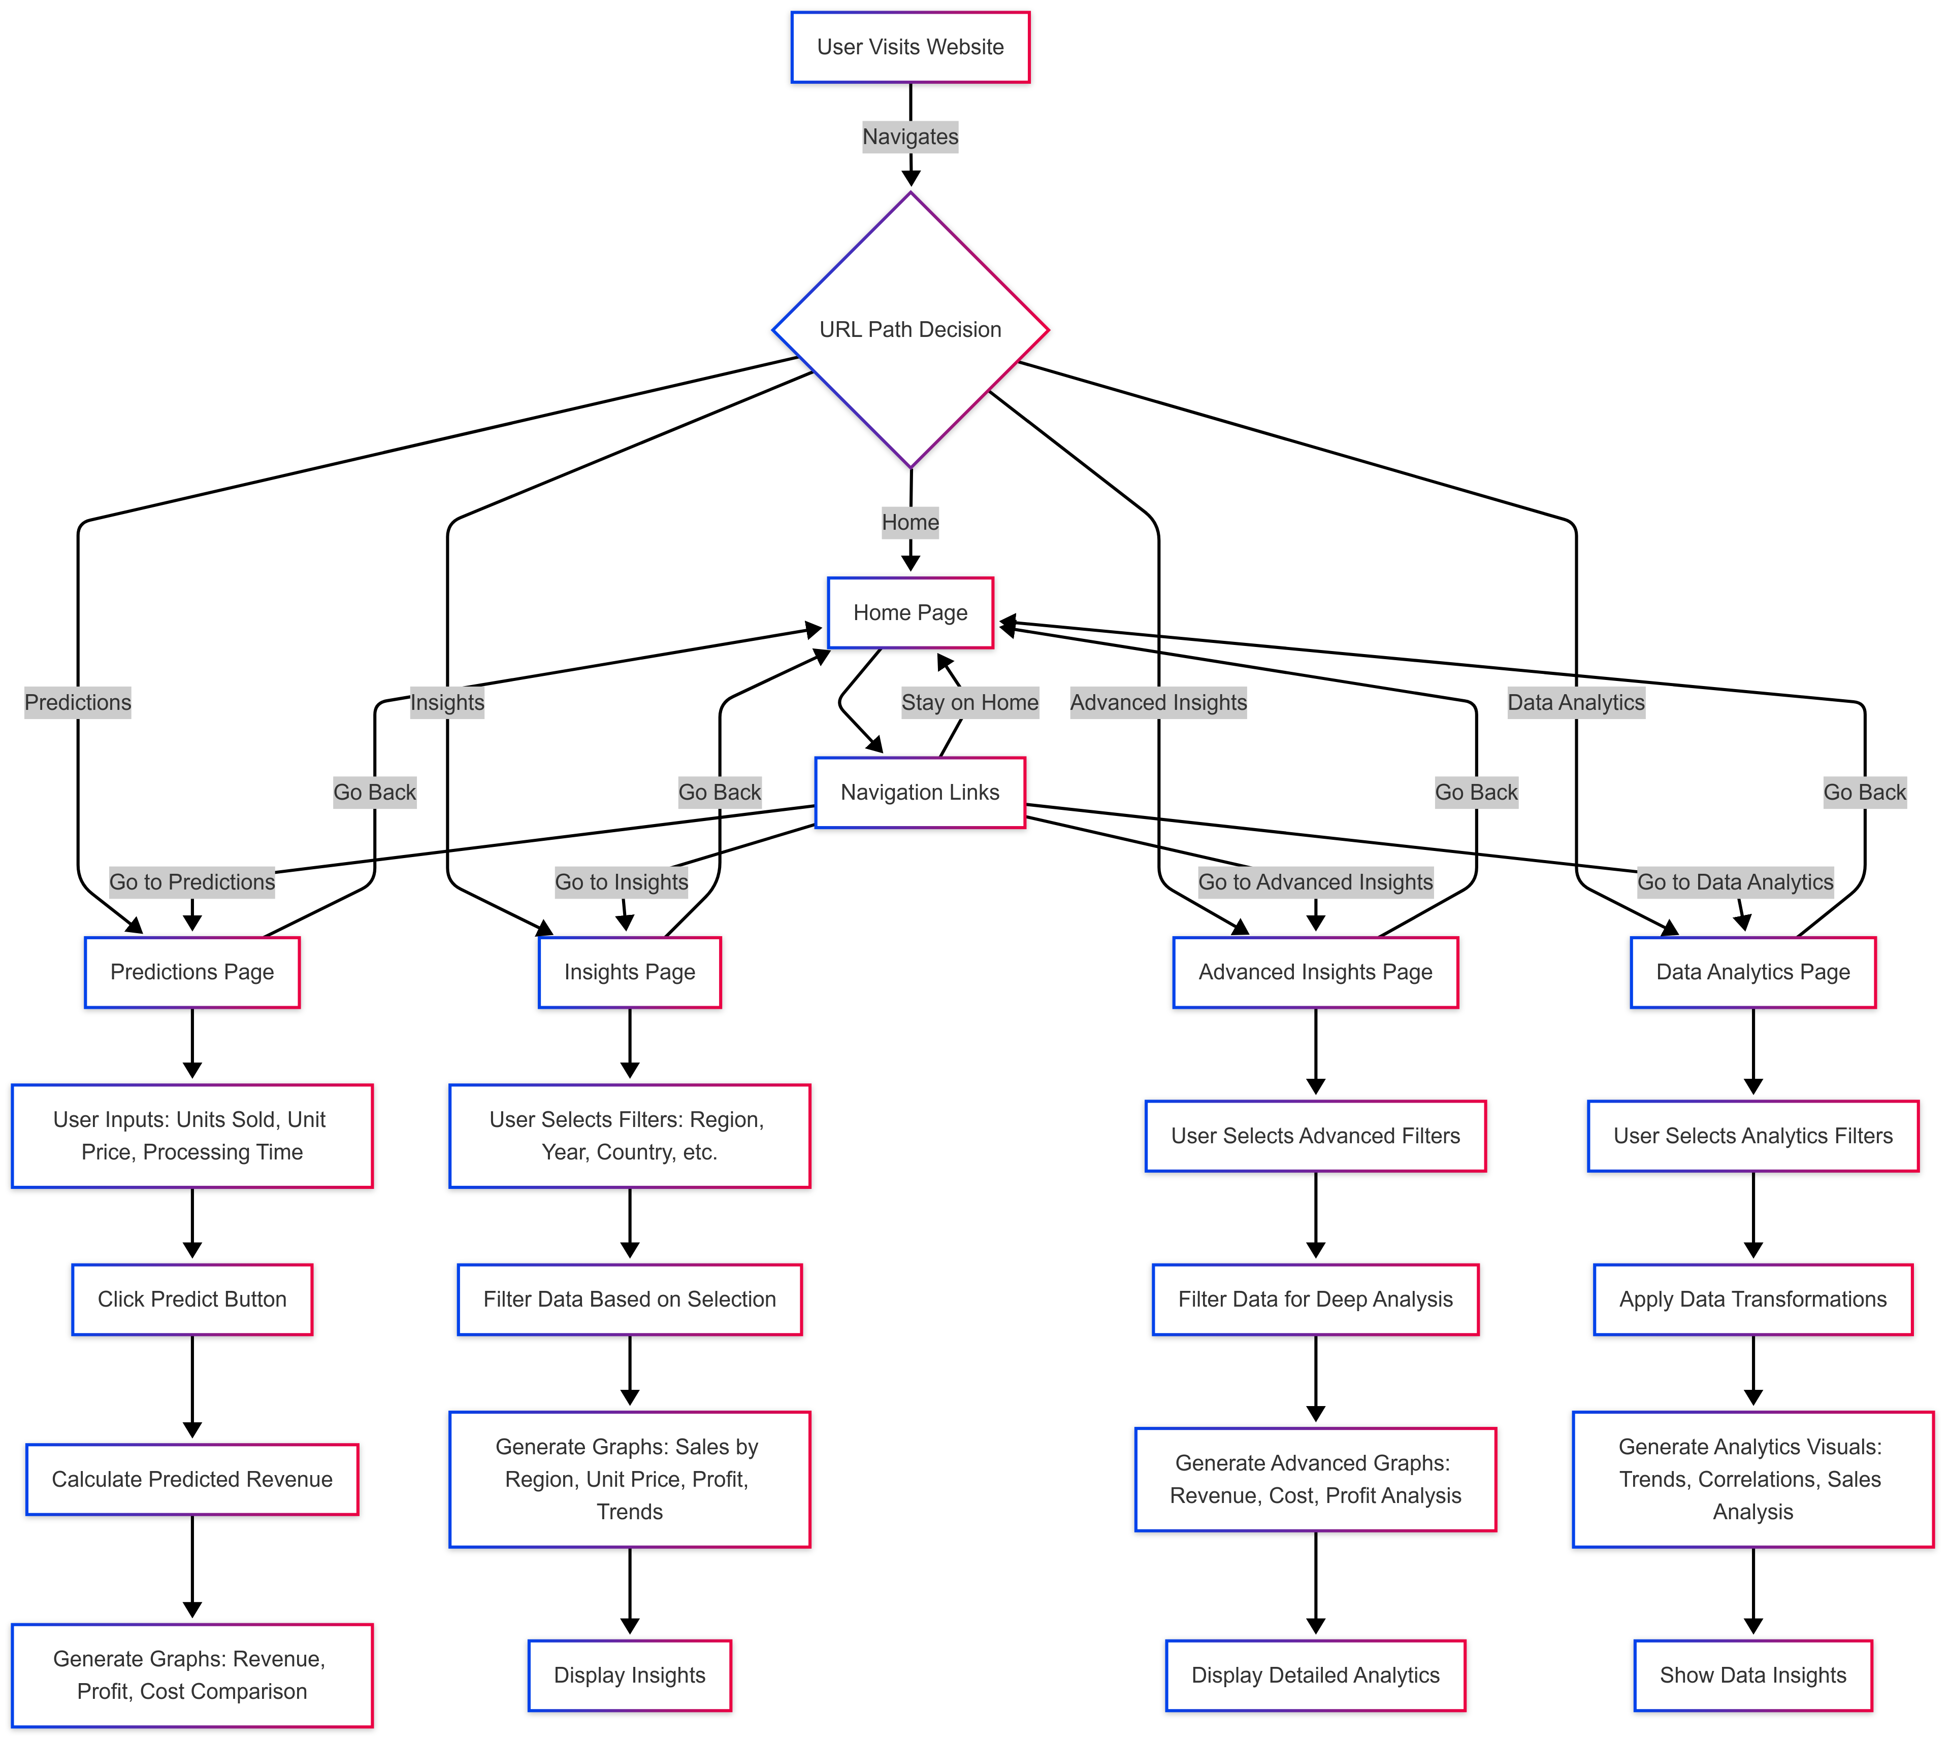
.
Flow Chart

Slide 16
Implementation.
1.Dynamic Data Filtering:
Allows users to filter Amazon sales data based on Product, Region, Order Priority, Year, and Unit Price to get customized insights.
2.Interactive Data Visualization:
Provides real-time updates of various graphs (e.g., Sales Trends, Revenue by Region, Unit Price Distribution) to help users analyze trends and performance across different metrics.
3.Sales Insights and Anomaly Detection:
Highlights key insights like outliers in costs or revenue dips, helping users identify potential issues or areas for improvement.
4.Real-Time Data Processing:
Ensures that the dashboard updates dynamically based on the user’s selections, offering up-to-date, accurate visualizations.
5.User-Friendly Interface:
Features an intuitive dashboard where users can easily filter data, view visualizations, and make data-driven decisions based on insights from the sales data.

Slide 17
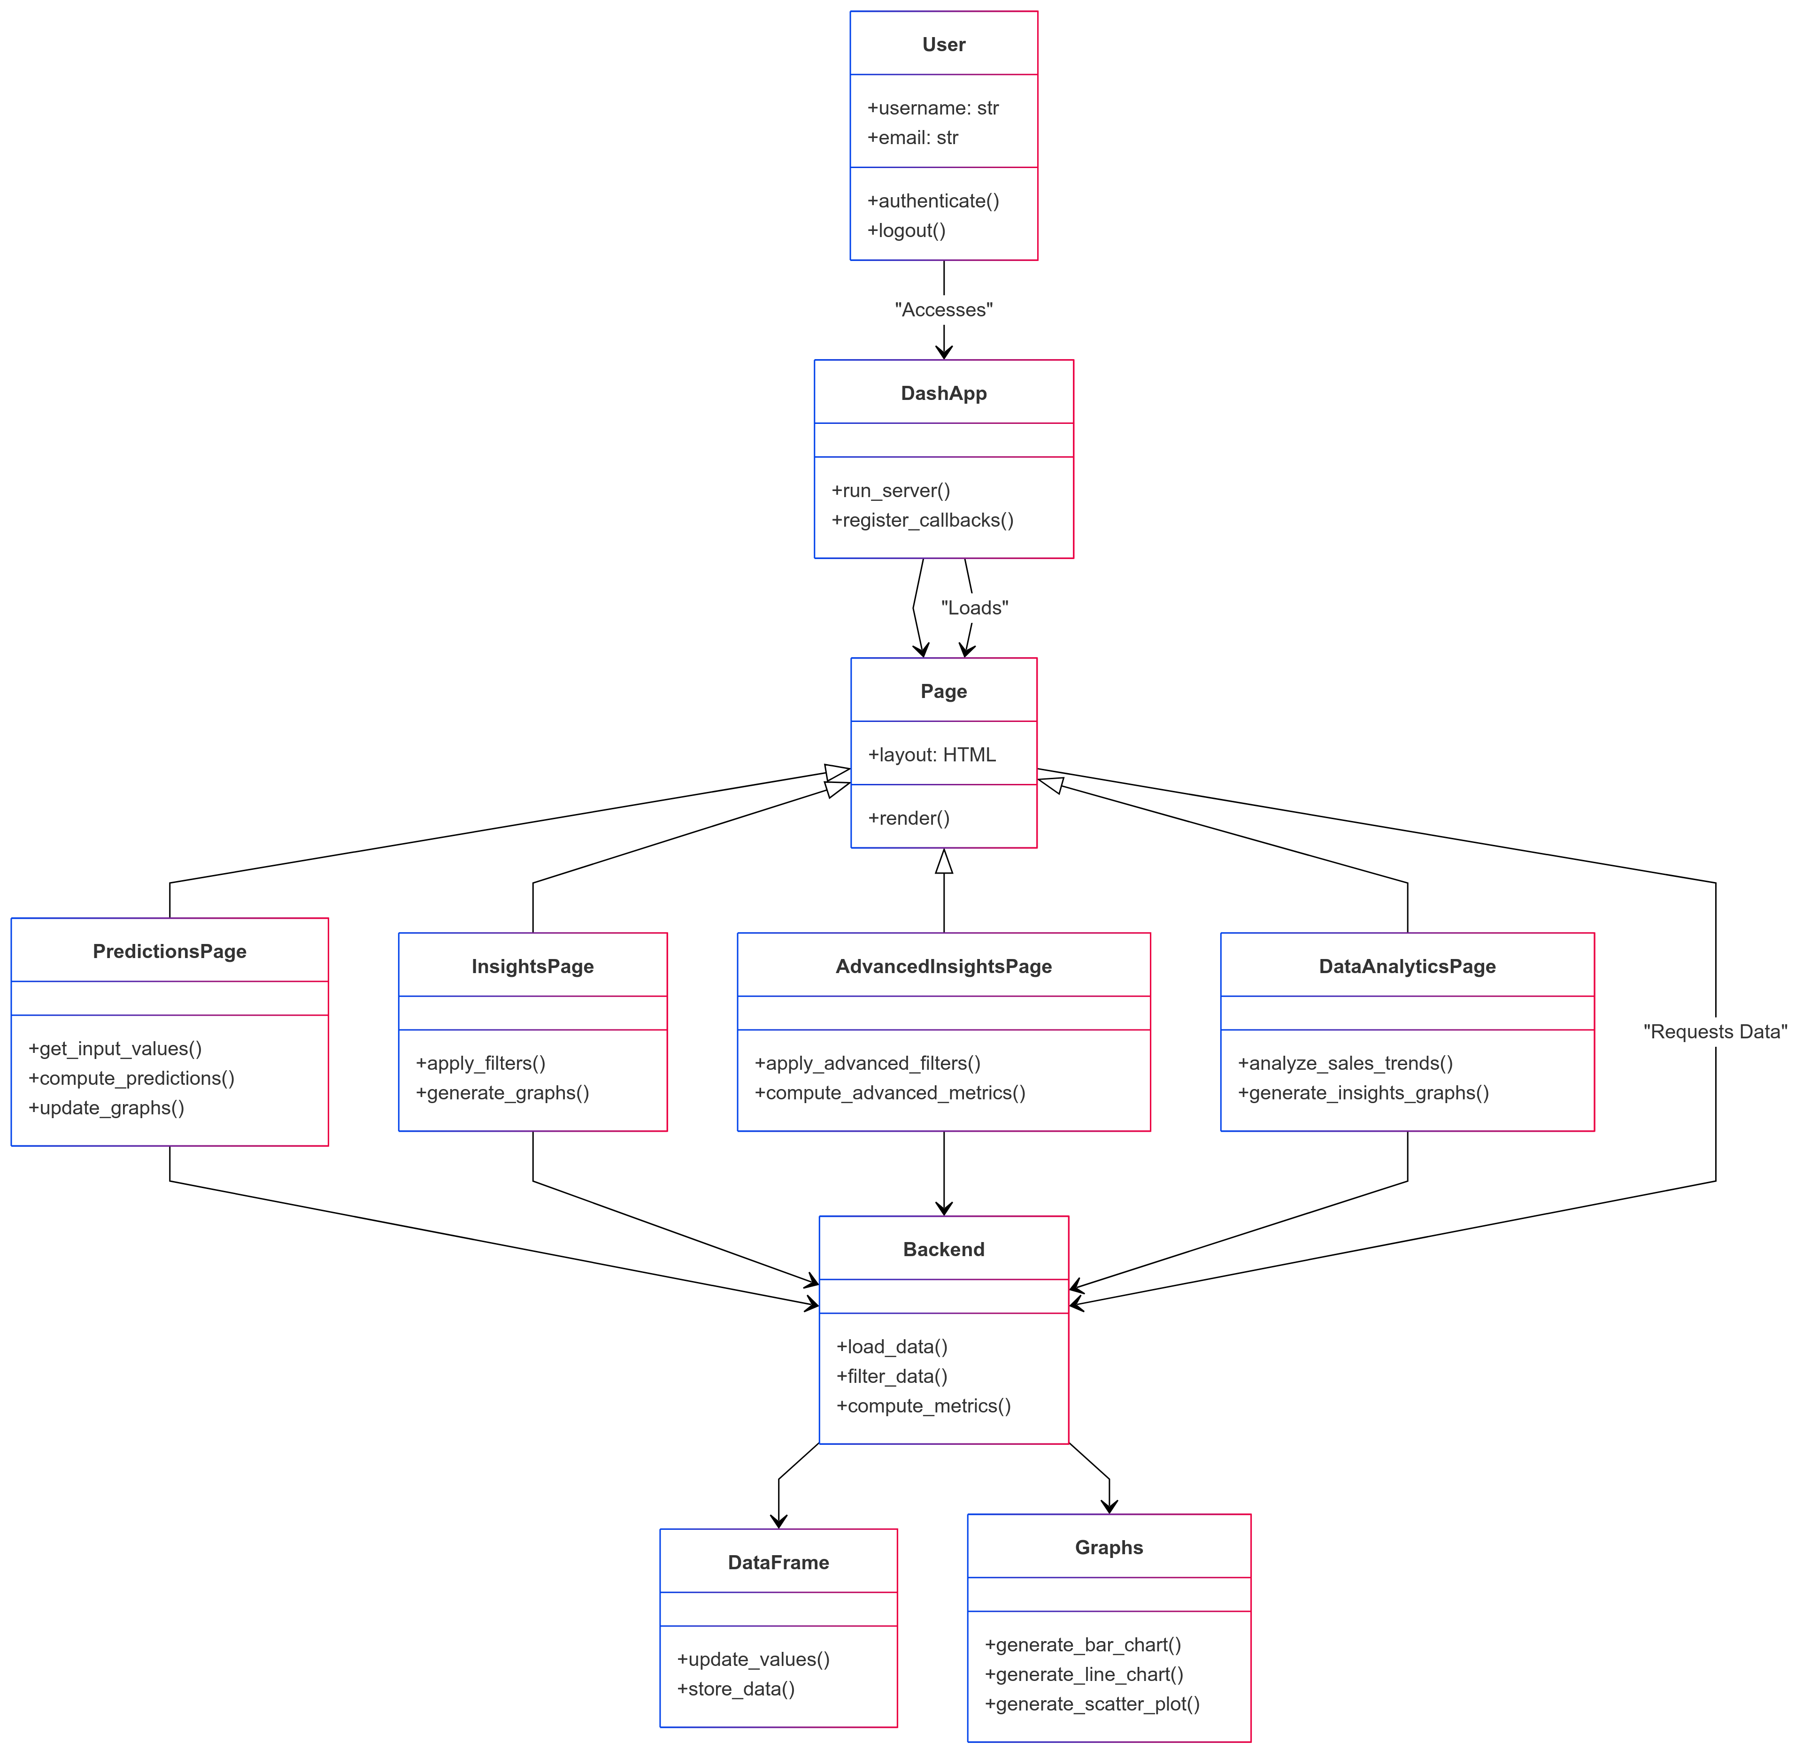
ClassDiagram

Slide 18
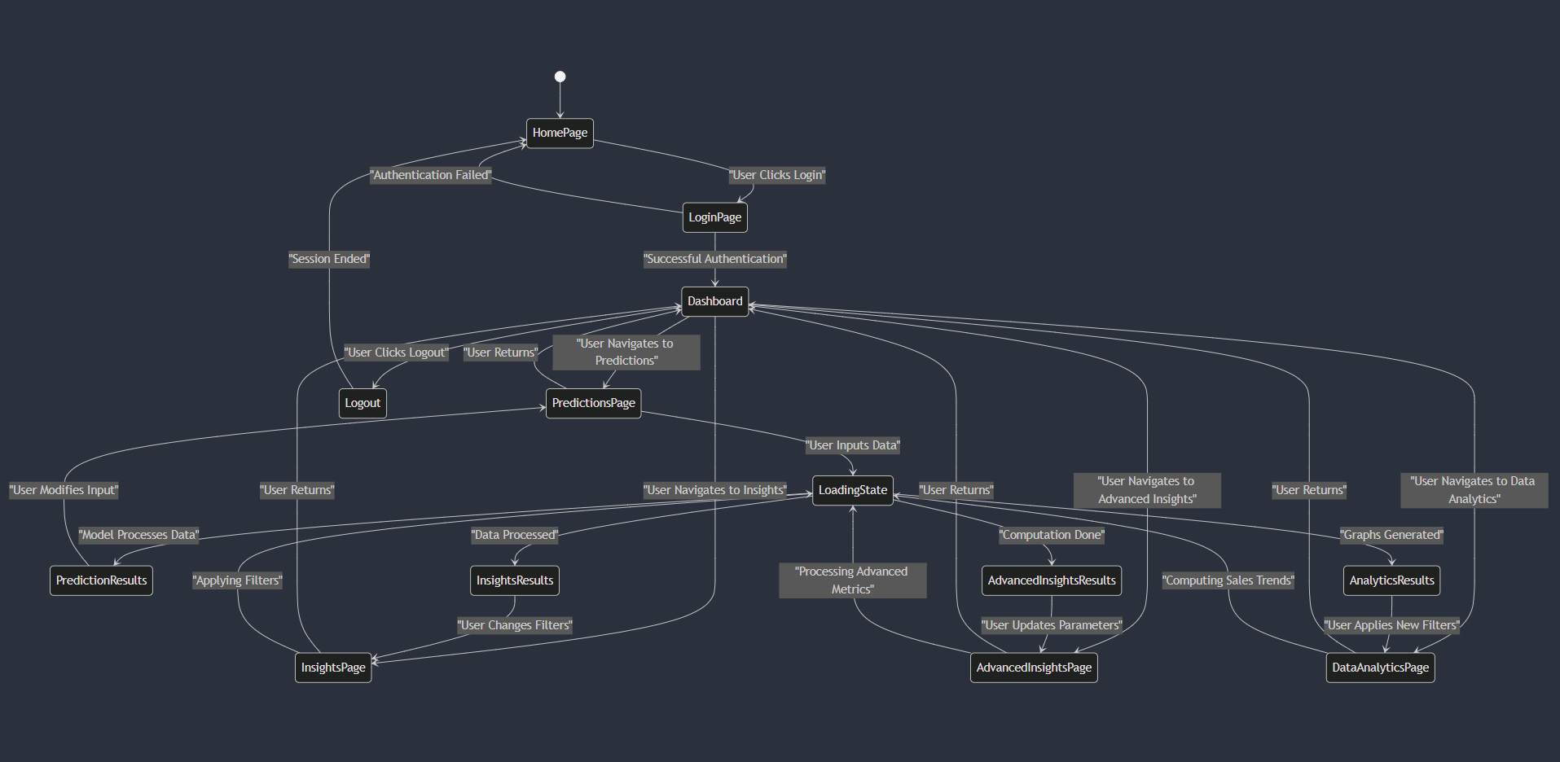
StateDiagram

Slide 19
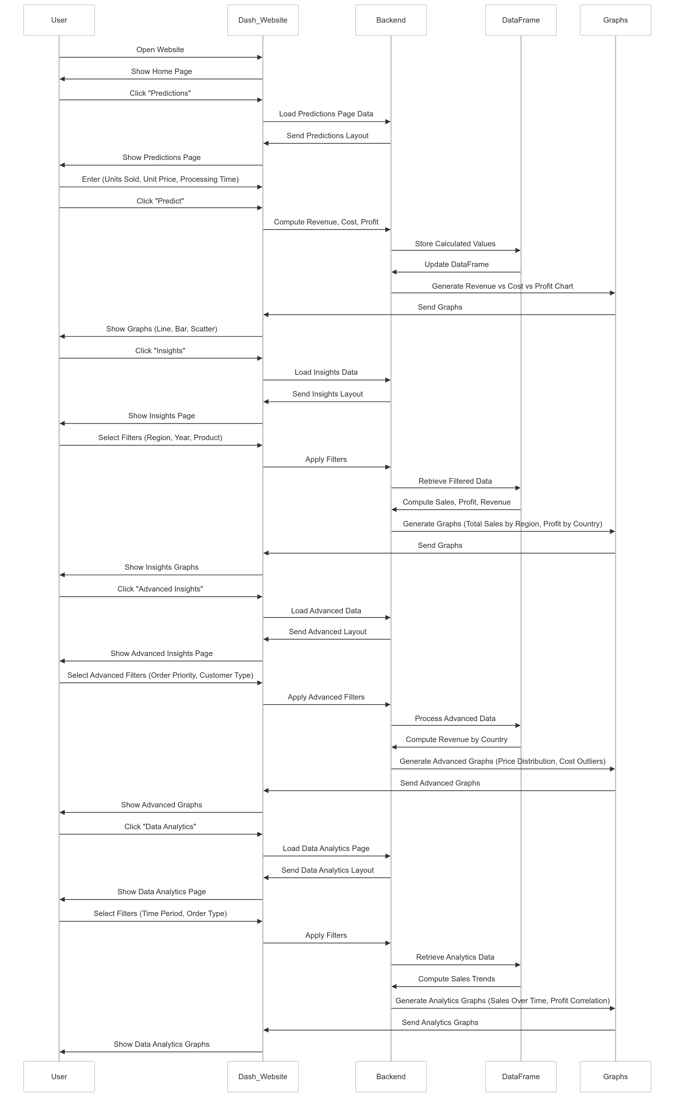
SequenceDiagram

Slide 20
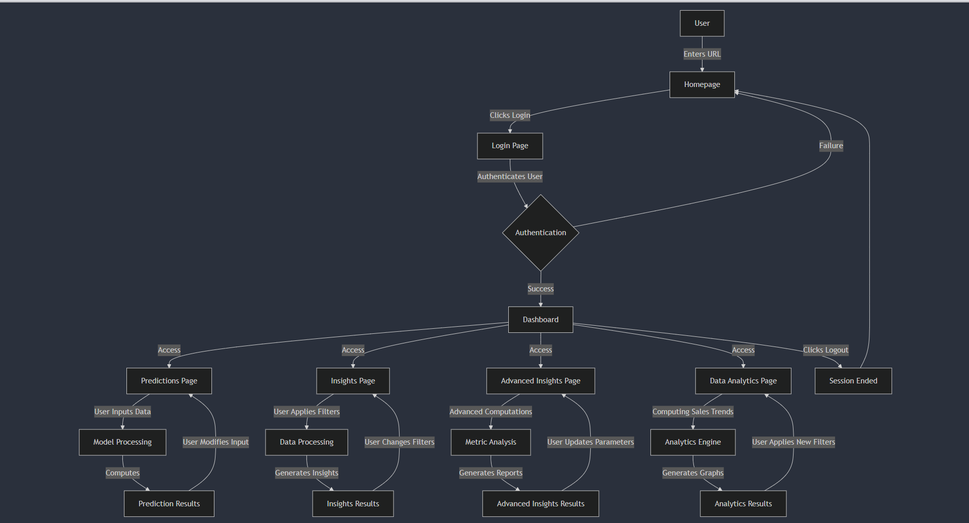
BlockDiagram

Slide 21
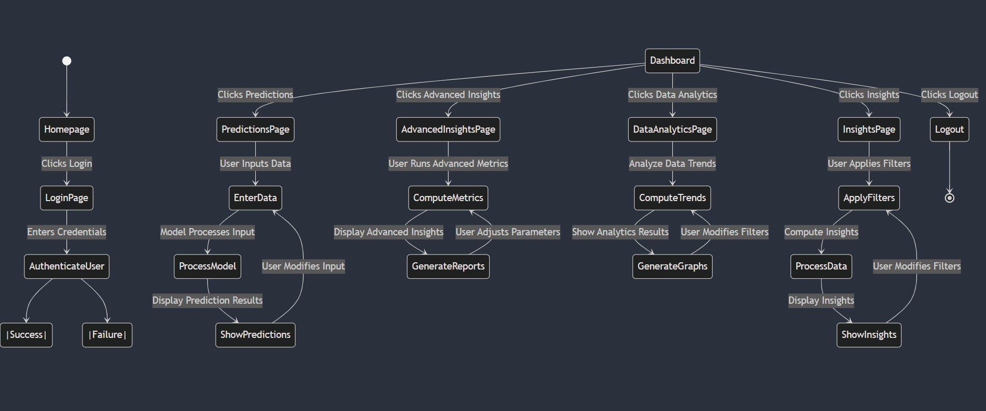
Activity Diagram

Slide 22
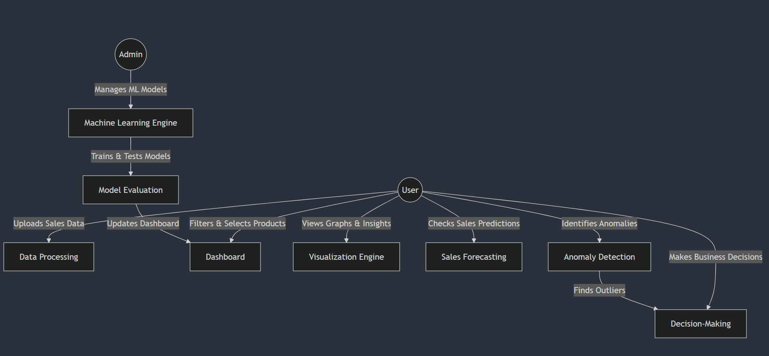
Use Case Diagram

Slide 23
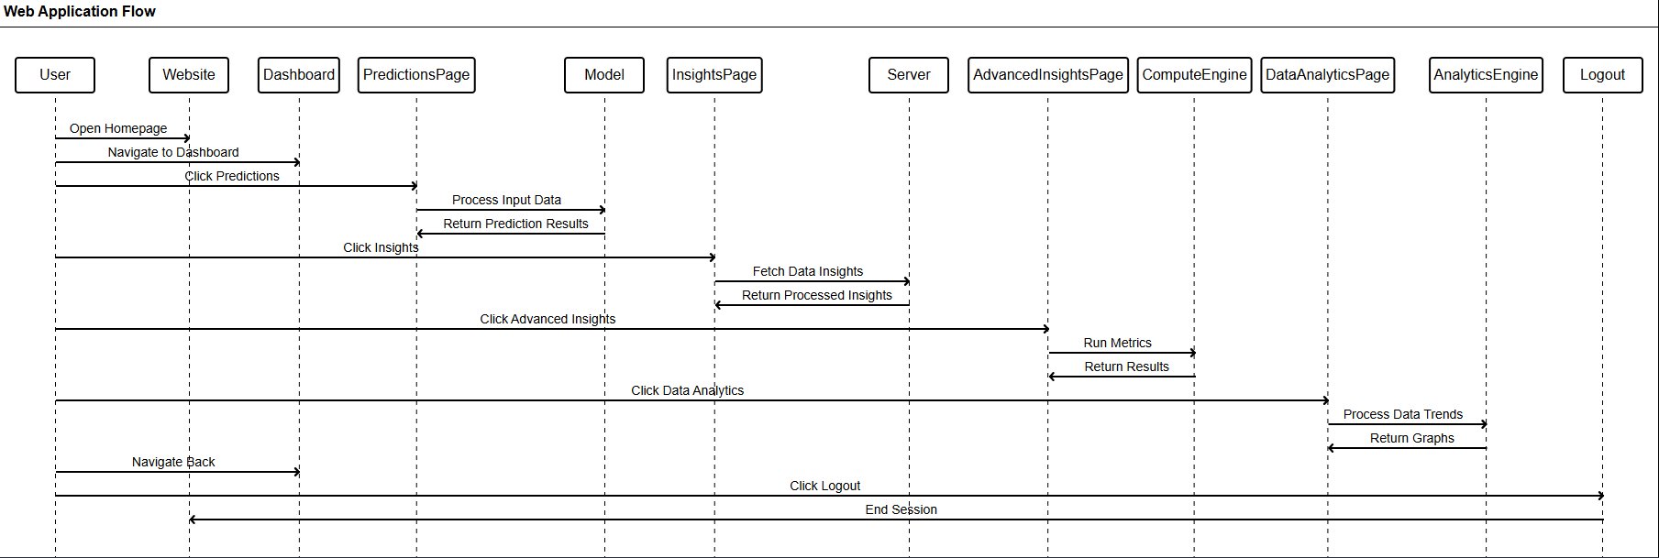

Slide 24
Results.
1. Interactive Visualizations: Real-time graphs help users analyze sales data across various metrics.
2. Efficient Filtering: Users can filter data by **Product**, **Region**, **Order Priority**, etc., for targeted insights.
3. Trend Identification & Anomalies: Users can spot sales trends, cost outliers, and revenue dips.
4. Real-Time Updates: Dashboard updates instantly with filter changes.
5. Data-Driven Decisions: Helps businesses optimize strategies based on insights.
6. User-Friendly: Simple design for easy navigation.
Discussion:
The tool provides actionable insights and can be enhanced with features like **predictive analytics** and **advanced anomaly detection**.

Slide 25
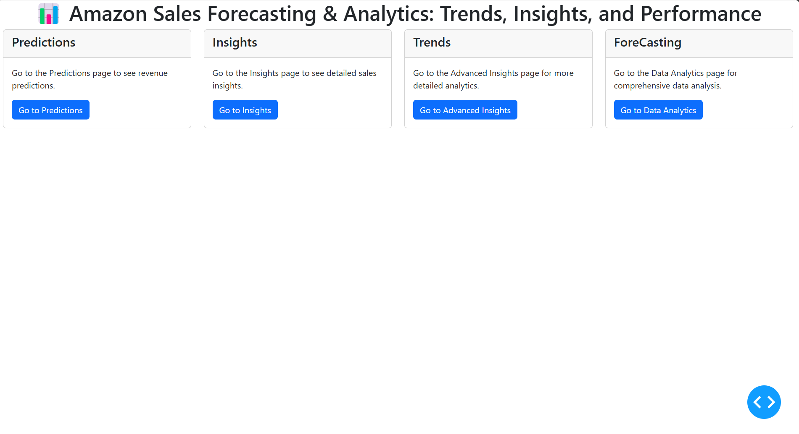
Main Page

Slide 26
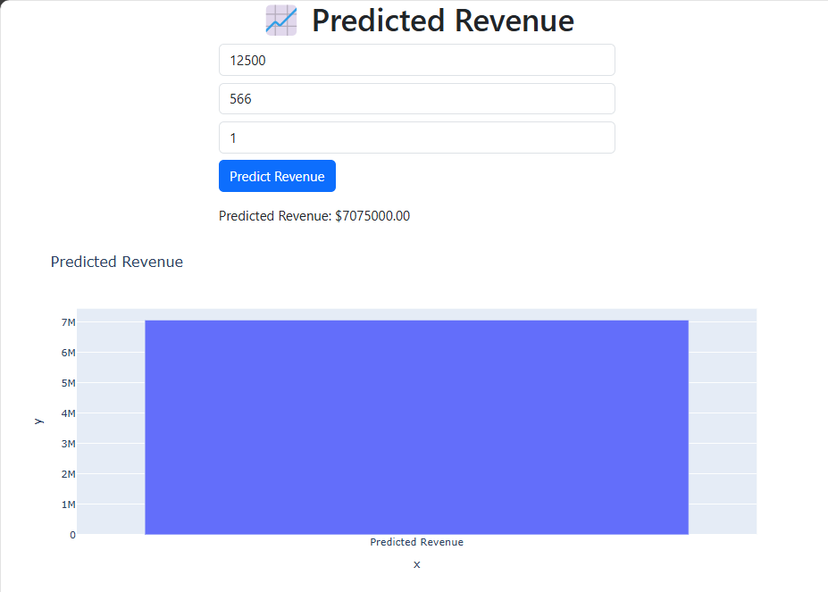
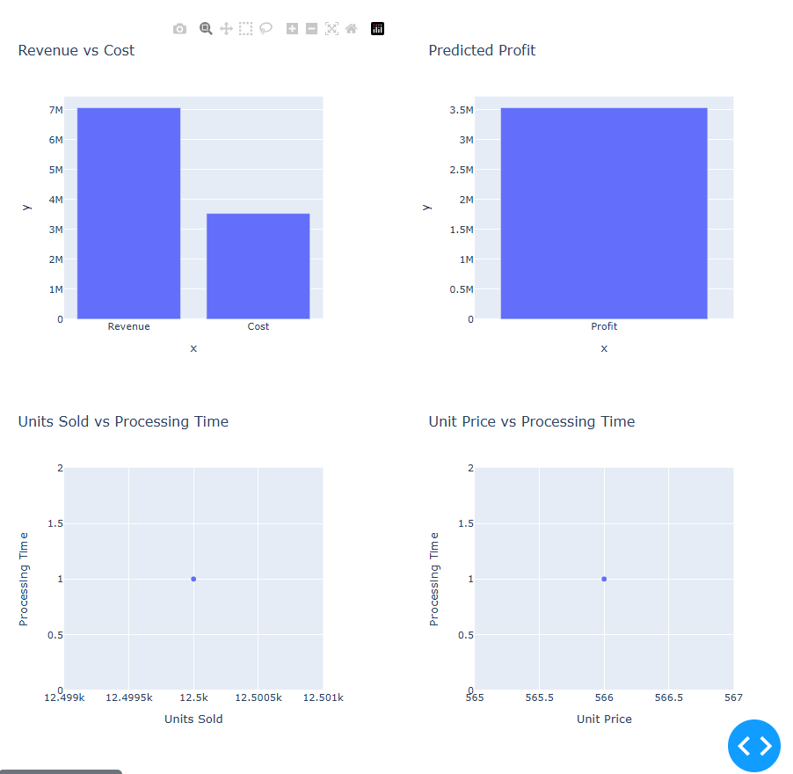

Slide 27
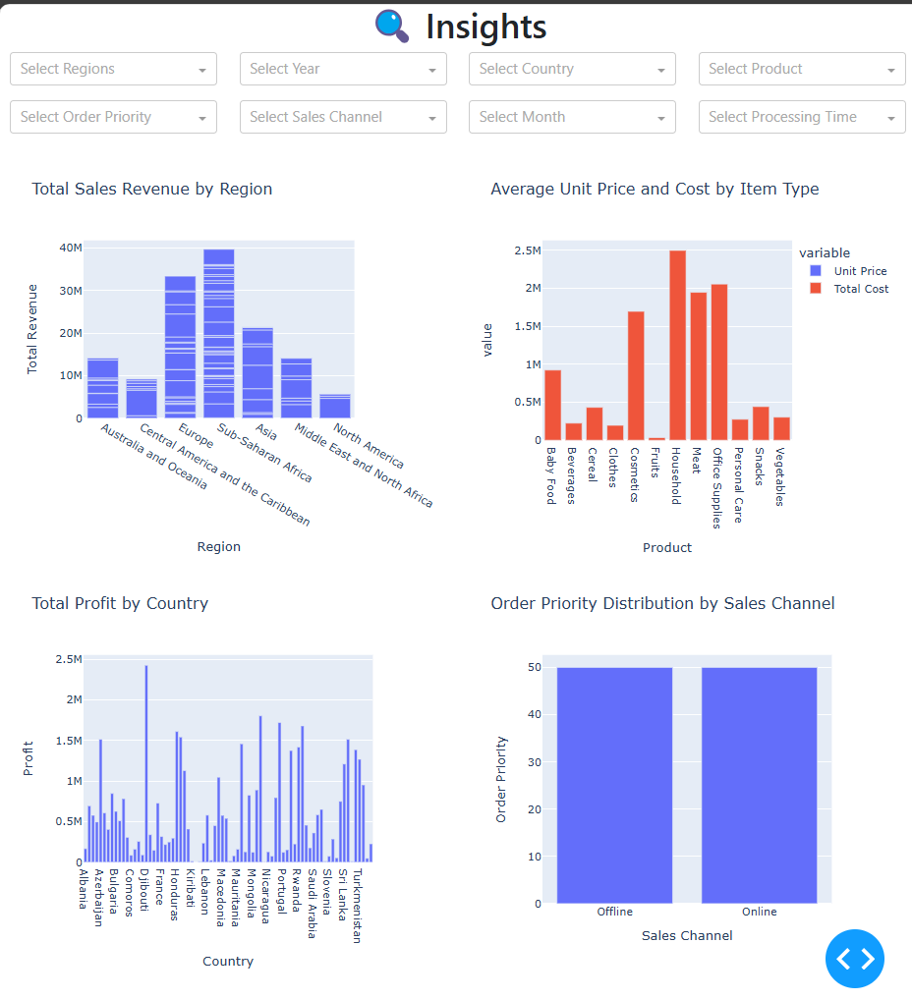
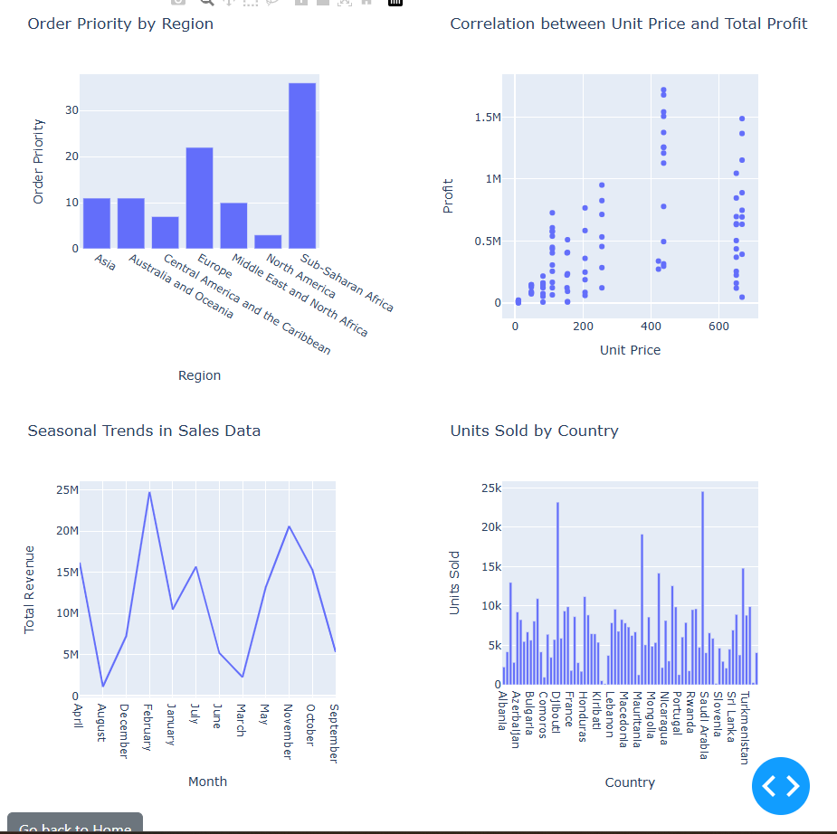

Slide 28
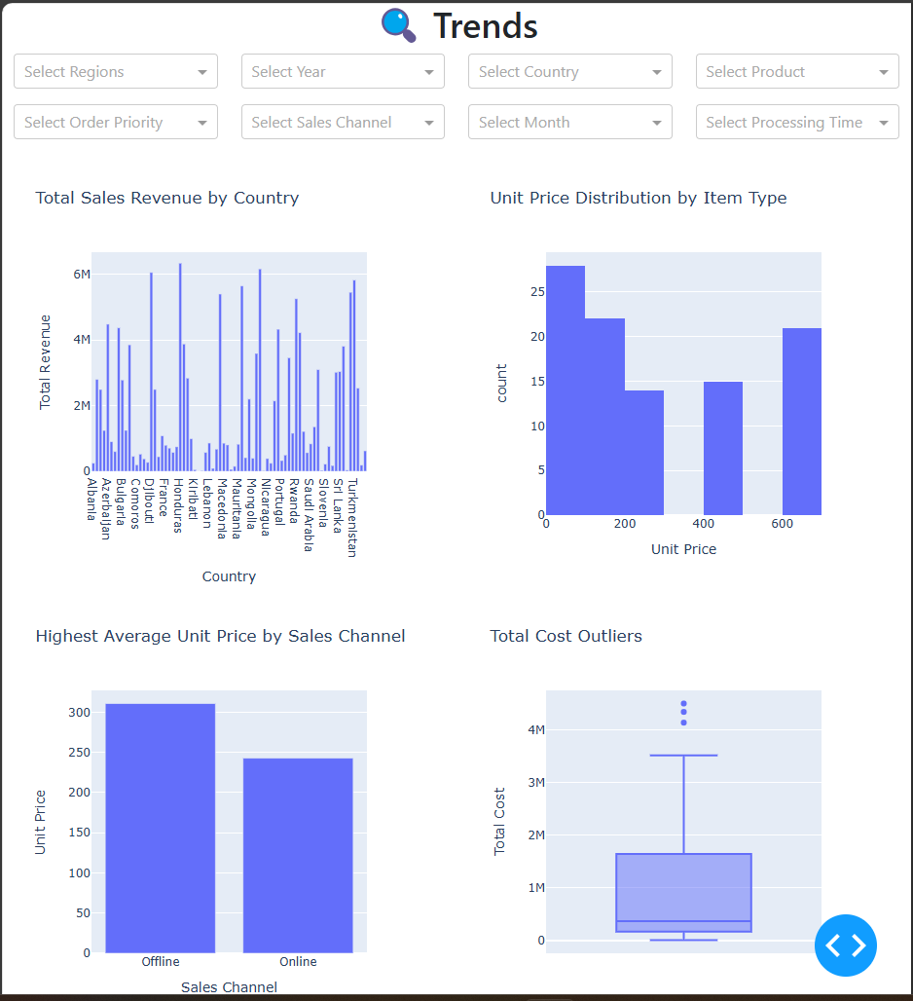
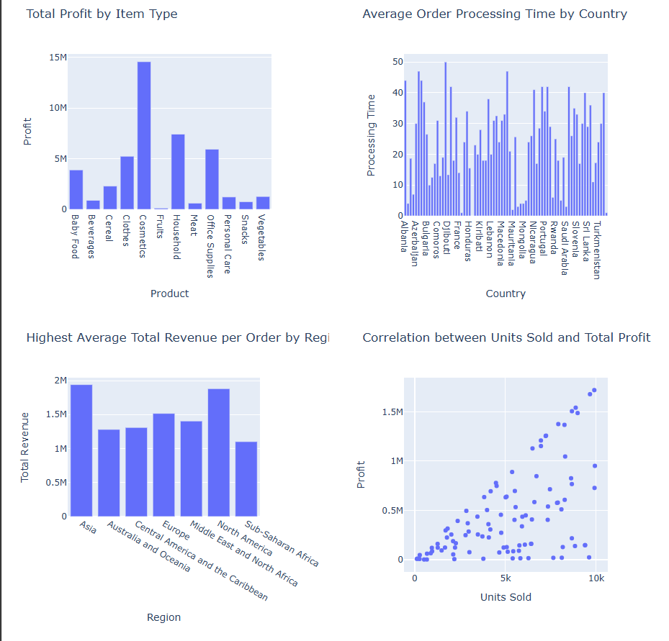

Slide 29
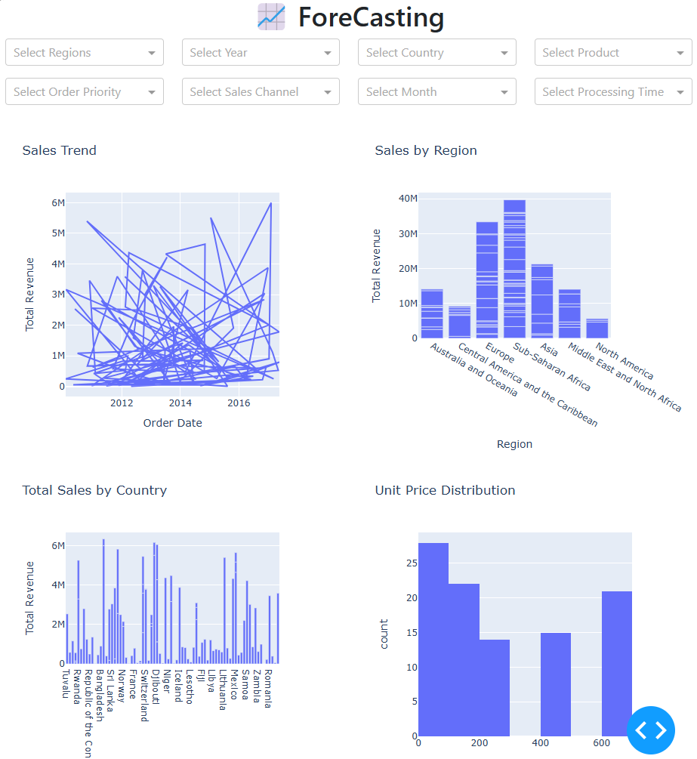
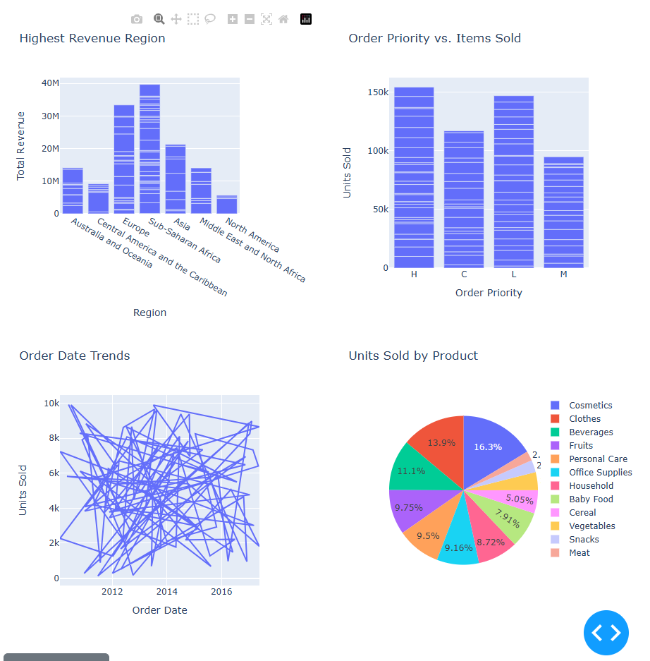

Slide 30
Conclusion .
Conclusion:
The Amazon Sales Data Analysis tool effectively empowers businesses to derive valuable insights from their sales data. By providing real-time visualizations, dynamic filtering, and the ability to track key metrics, the application enables users to make informed decisions, optimize sales strategies, and identify growth opportunities. Its user-friendly interface ensures accessibility for both technical and non-technical users. This tool plays a crucial role in improving business performance and profitability through data-driven insights.
Future Scope:
Personalized Dashboards: Allowing users to customize their dashboards based on their specific business needs, enhancing the user experience.
Integration with Business Tools: Enabling the platform to integrate with other business systems like CRM and ERP for a comprehensive analytics ecosystem.
Real-Time Market Insights: Expanding to include real-time market and competitor data for more contextual decision-making.
Voice Integration: Incorporating AI-powered voice assistants to allow users to interact with the system hands-free.

Slide 31
References
[1]. Sharma, R., & Patel, D. (2022). "The Role of Data Analytics in E-commerce Growth." *International Journal of Business Intelligence*.
[2]. McKinsey & Company. (2023). "Harnessing Data for E-commerce Success." *McKinsey Insights*. Retrieved from [https://www.mckinsey.com](https://www.mckinsey.com).
[3]. Amazon Web Services. (2022)."ETL Best Practices for Large-Scale E-commerce Data." *AWS Documentation*. Retrieved from [https://aws.amazon.com](https://aws.amazon.com).
[4]. Gupta, A., & Roy, S. (2021). "Sales Trend Analysis Using Power BI and Python." *Proceedings of the Data Science Conference*.
[5]. Kamat, R., & Gupta, P. (2022). "Enhancing Sales Analytics with Power BI: A Case Study on E-commerce Data." *International Journal of Business Analytics*.

Slide 32
THANK YOU

